Slide 1
Technobuiz Maharashtra Minority NGO Forum
By- Prof. Ashfaq m. khan
Managing Director, sir Einstein academy, panchgani
Coordinator, technobuiz

Slide 2
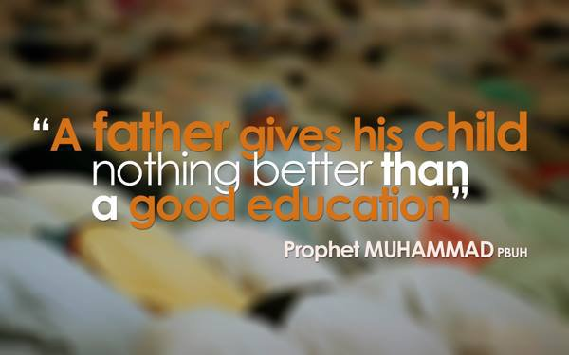

Slide 3
1) Career guidance
Guidance about
Secondary (Class 8th to 10th )
Higher secondary, (Class 11th & 12th )
Degree and diploma
Post graduation
Research level education
Providing information about various courses, institutes and admission process

Slide 4
2)Assistance in Entrance exams
Guidance about preparation of
Engineering Entrance exams like IIT-JEE, BITSAT, MH CET
Medical and nursing entrance exams like NEET, JIPMER
Pharmacy, law entrance exams like MH CET, CLAT
Kishore Vaigyanik Protsahan Yojana (KVPY)
NDA, NATA
‘UDAAN’ – A sponsorship program for preparation of these exams for economically weak students

Slide 5
3)Assistance in documentation to Ready for Admission
Documents needed for various admission and process to get them
Domicile, nationality
Caste certificate
Caste validity
EWS

Slide 6
4)Assistance to complete online admission.
Counseling process of admission in
Engineering (CAP process)
Medical (Counselling process)
Pharmacy (CAP process)
Law
Other professional courses

Slide 7
5)Assistance in Scholarships and education loans
Pre-matric Scholarships
Post-matric scholarships
Merit-cum-means scholarship for professional and technical courses CS
Begum Hazrat Mahal national scholarship scheme for minorities girls
Swami Vivekananda merit cum means scholarship scheme for minorities
Padho pardes loan

Slide 8
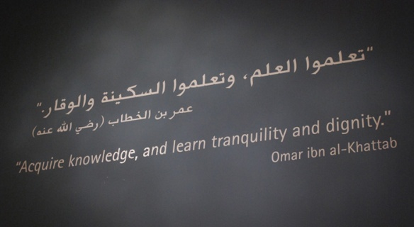

Slide 9
6) Talent search program since Age of 3 years child.
Awareness programs for students with spark
Boosting the hidden talents of child from age 3
Nourishing the development of children with spark
Providing guidance about various schemes related to particular age group

Slide 10
7)Data collecting of educational institutions driven by Muslims and make a state level platform.
Connecting the talented students on a common platform
Creating database of educational institutions driven by Muslims

Slide 11
8)Teacher training institute
Developing skills like presentation, communication in graduate candidates and making them able for professional life.
Establishing teacher training institute in each city and expanding this mission.

Slide 12
9) Infrastructural modernization and sustainable development of minority institutions
Consultancy for minority institutes (minority run, aided-non aided) to make them competitive, modern and sustainable.
Act as a bridge between the institutes and the funding bodies.

Slide 13
10)Educational standardization improvement program for each minority institution
Making the minority institutes standard from educational point of view.
Helping them become more competitive and accreditable

Slide 14
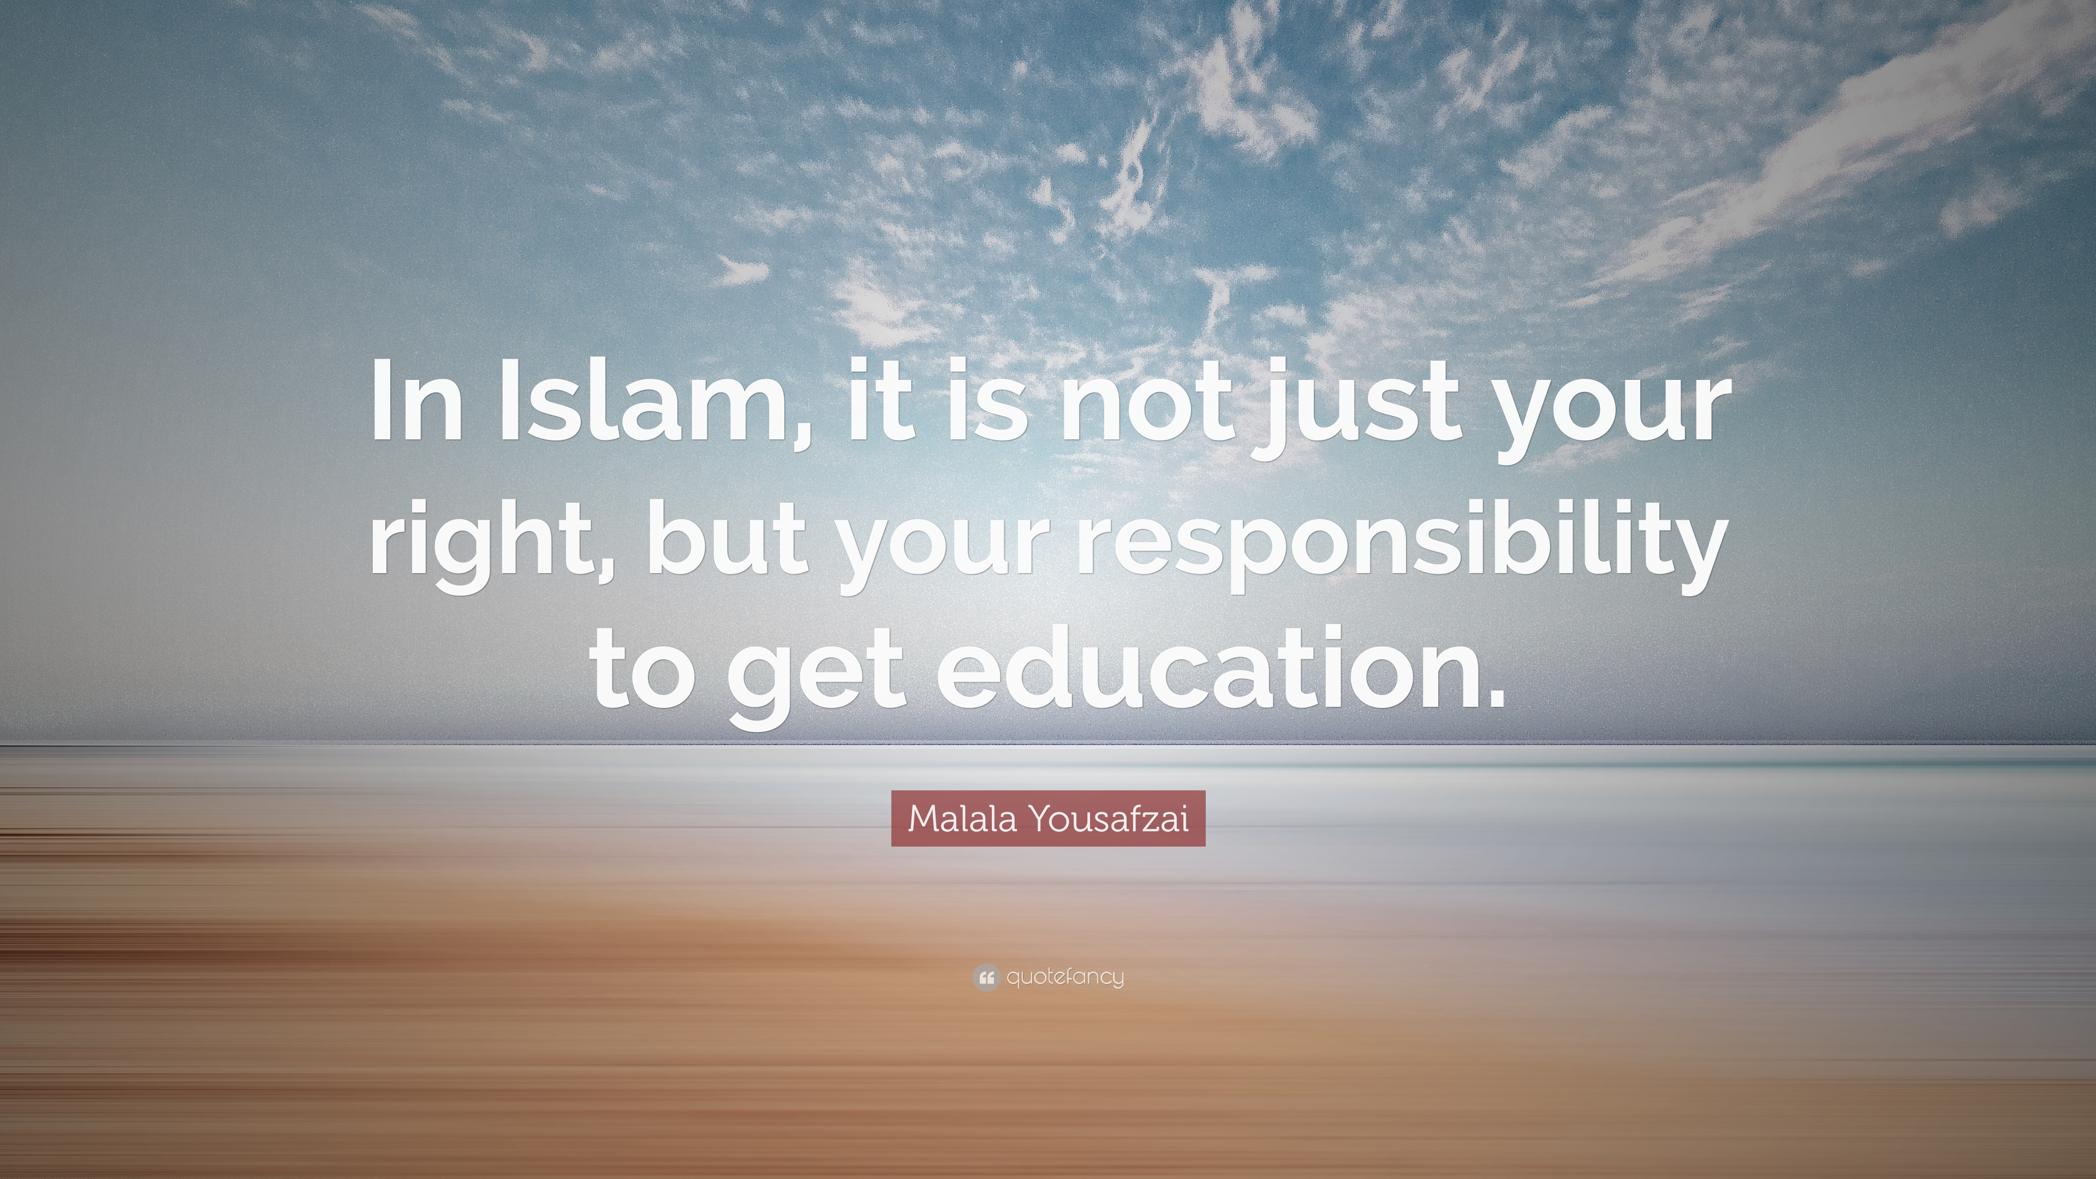

Slide 15
11) Creating one residential School equivalent to Navodaya, military school.
Establishing one residential school for minority students on the basis of Navodaya or military schools.
Making the students aware about the residential school culture and integrated education

Slide 16
12) Creating online tracking system to parental mentoring of each Muslim student.
Considering the key role of parent in nourishment of child, creating online tracking system about the same.
Creating a mentoring system for the parent for educational, social and holistic development of child in a scientific way.

Slide 17
13)Design and develop a special curriculum in open schooling to improve graduates percentage
Supporting the students taking education in open schooling or open universities like NIOS, YCMOU, IGNOU
Creating a common platform for candidates to improve graduation percentage.

Slide 18
14)Design and develop curriculum based on technology, business, sustainable aspects specifically improve percentage Muslim research students.
Taking the traditional education to next level by curriculum based on technology, business etc. to specifically improve percentage of Muslim research students

Slide 19
15) To develop Advance Virtual educational system like Homeschooling
Developing advance virtual educational system like home-schooling
Promoting new ways of schooling

Slide 20
Technobuiz is a common platform where scholars with special educational achievements come together to train the upcoming candidates to become competitive and overall developed.
The same legacy is expected to be carried forwarded by the upcoming candidates

Slide 21
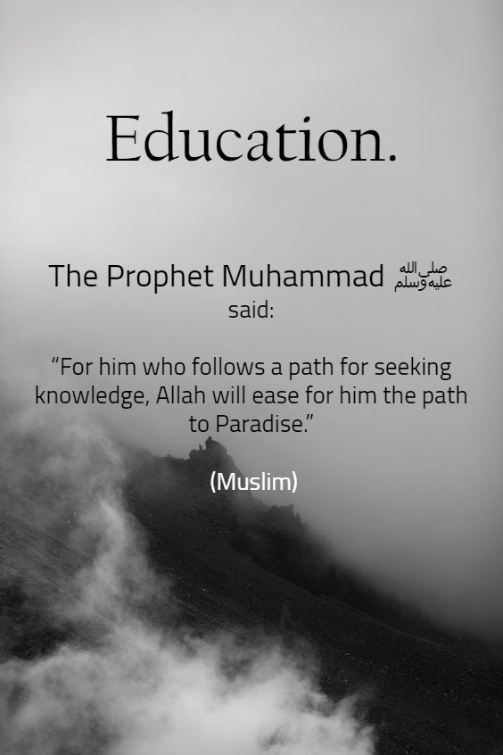

Slide 22
Thank you

